Slide 1


APPLICATION CHEMISTRY A2 LEVEL
ANALYTICAL CHEMISTRY CHAPTER 2:
DNA (GENETIC) FINGERPRINTING

Slide 2
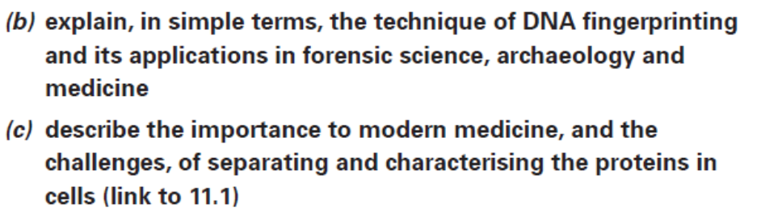
What you should know…

Slide 3
Genetic fingerprinting
Of the DNA contained within the chromosomes, only about 10% comprises the genes.
This small portion of “useful” DNA will be almost identical in most members of a particular species.
The other 90% of chromosomal DNA (the “useless” DNA) lies in between the genes. Highly variable in its base sequences.
These portions often contain sequences of bases (about 10-50 base pairs in length) that are repeated several times.

Slide 4
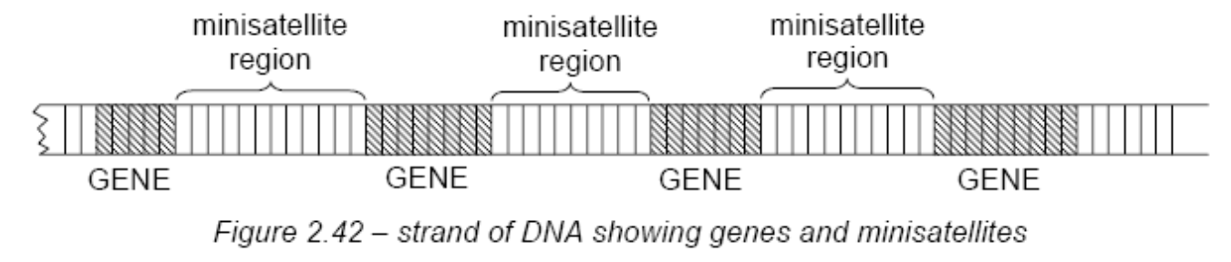
Genetic fingerprinting
All members of the same species have these repeats, but individuals vary in the number of times each sequence is repeated.
Termed minisatellites, or VNTRs (variable number of tandem repeats)
Short sequences (2-5 base-pairs) that are repeated many times. These are termed short tandem repeats (STRs), or microsatellites

Slide 5
Genetic fingerprinting
The key to genetic fingerprinting is that an individual’s pattern of VNTRs or STRs is entirely unique – no one else (except an identical twin) will have the same pattern
Members of a family throughout many generations will have similar minisatellite patterns to each other.

Slide 7
Technique
Starts with the extraction of the DNA from a sample of chromosomal material, such as blood (only the white cells contain DNA), hair, inner cheek cells, semen or skin.
The DNA is then broken into fragments by a restriction enzyme.
Restriction enzyme recognizes and cuts DNA only at a particular sequence of nucleotides.
There is a range of these enzymes available, each one breaking the DNA at several different, but known and specific, places.
This produces fragments that can now be subjected to electrophoresis.

Slide 8
Technique
Polymerase chain reaction (PCR) can be used when the amount of available DNA is smaller.
After the DNA has been broken up into pieces in the usual way, an individual segment is extracted.
Heating a solution of the segment separates the two DNA strands from each other.
The sample is then cooled and a short “primer” length of DNA which matches the end of the segment is added, together with the enzyme DNA polymerase and the four monomer nucleotides A, G, C, T.
On warming, the bases will bind together.

Slide 9
Technique
The process is repeated many times until a sufficient amount of DNA has been made.
Samples of DNA to be analysed are placed in wells near the cathode of an agarose gel plate.
Since the phosphate groups of DNA are negatively charged, all DNA samples will move towards the anode, but the smaller fragments will move faster than the larger ones.

Slide 10
Technique
Discovering the positions of the separated fragments requires a special technique.
DNA fragments are transferred from the gel onto a nylon membrane and are broken into single strands by soaking in dilute alkali.
The membrane is then soaked in a solution containing short lengths of DNA identical to the minisatellite sequence, but labelled with radioactive ³²P.
³²P DNA thus sticks to the membrane where the DNA fragments are situated, and if an X-ray sensitive film is placed over the plate, it will record the pattern originally on the gel plate

Slide 11
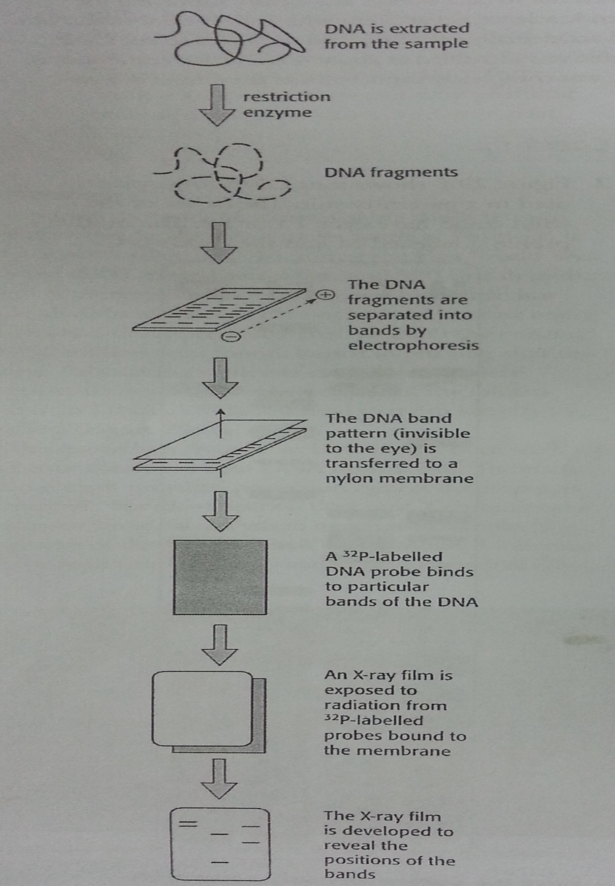
The process of producing a genetic fingerprint.

Slide 12
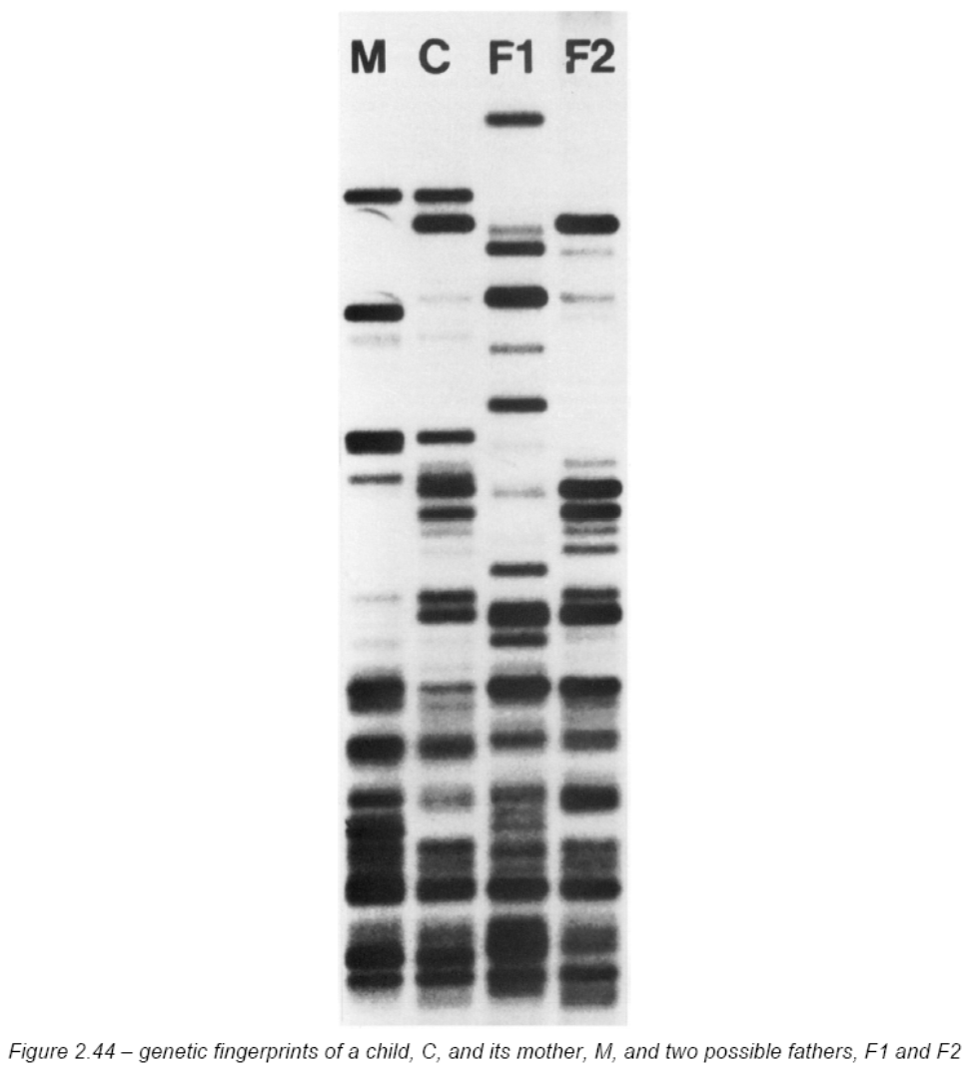

Slide 13
The uses of genetic fingerprinting
Genetic fingerprinting has been used in :
paternity testing
establishing other familial relationships – between both the living and the dead
establishing the relationship between archaeological artefacts
forensic testing
medicine

Slide 14
The uses of genetic fingerprinting
A child inherits one set of chromosomes from its mother, and the other set from its father.
The child’s fragments correspond with those of its mother, together with those of possible father F2, but show little correspondence to those of possible father F1.
Medical applications have included the investigations of whether cases of tuberculosis or cancers are re-infections from previous illnesses, or brand new infections.

Slide 15
